Slide 1
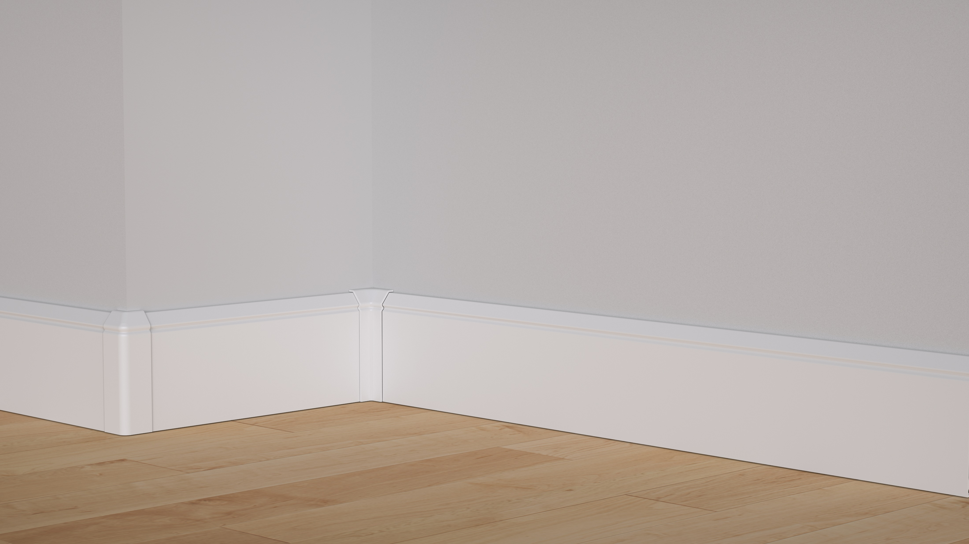

Discover the future of home heating, harnessing the power of infrared & radiant heat to heat faster using less energy

Slide 2
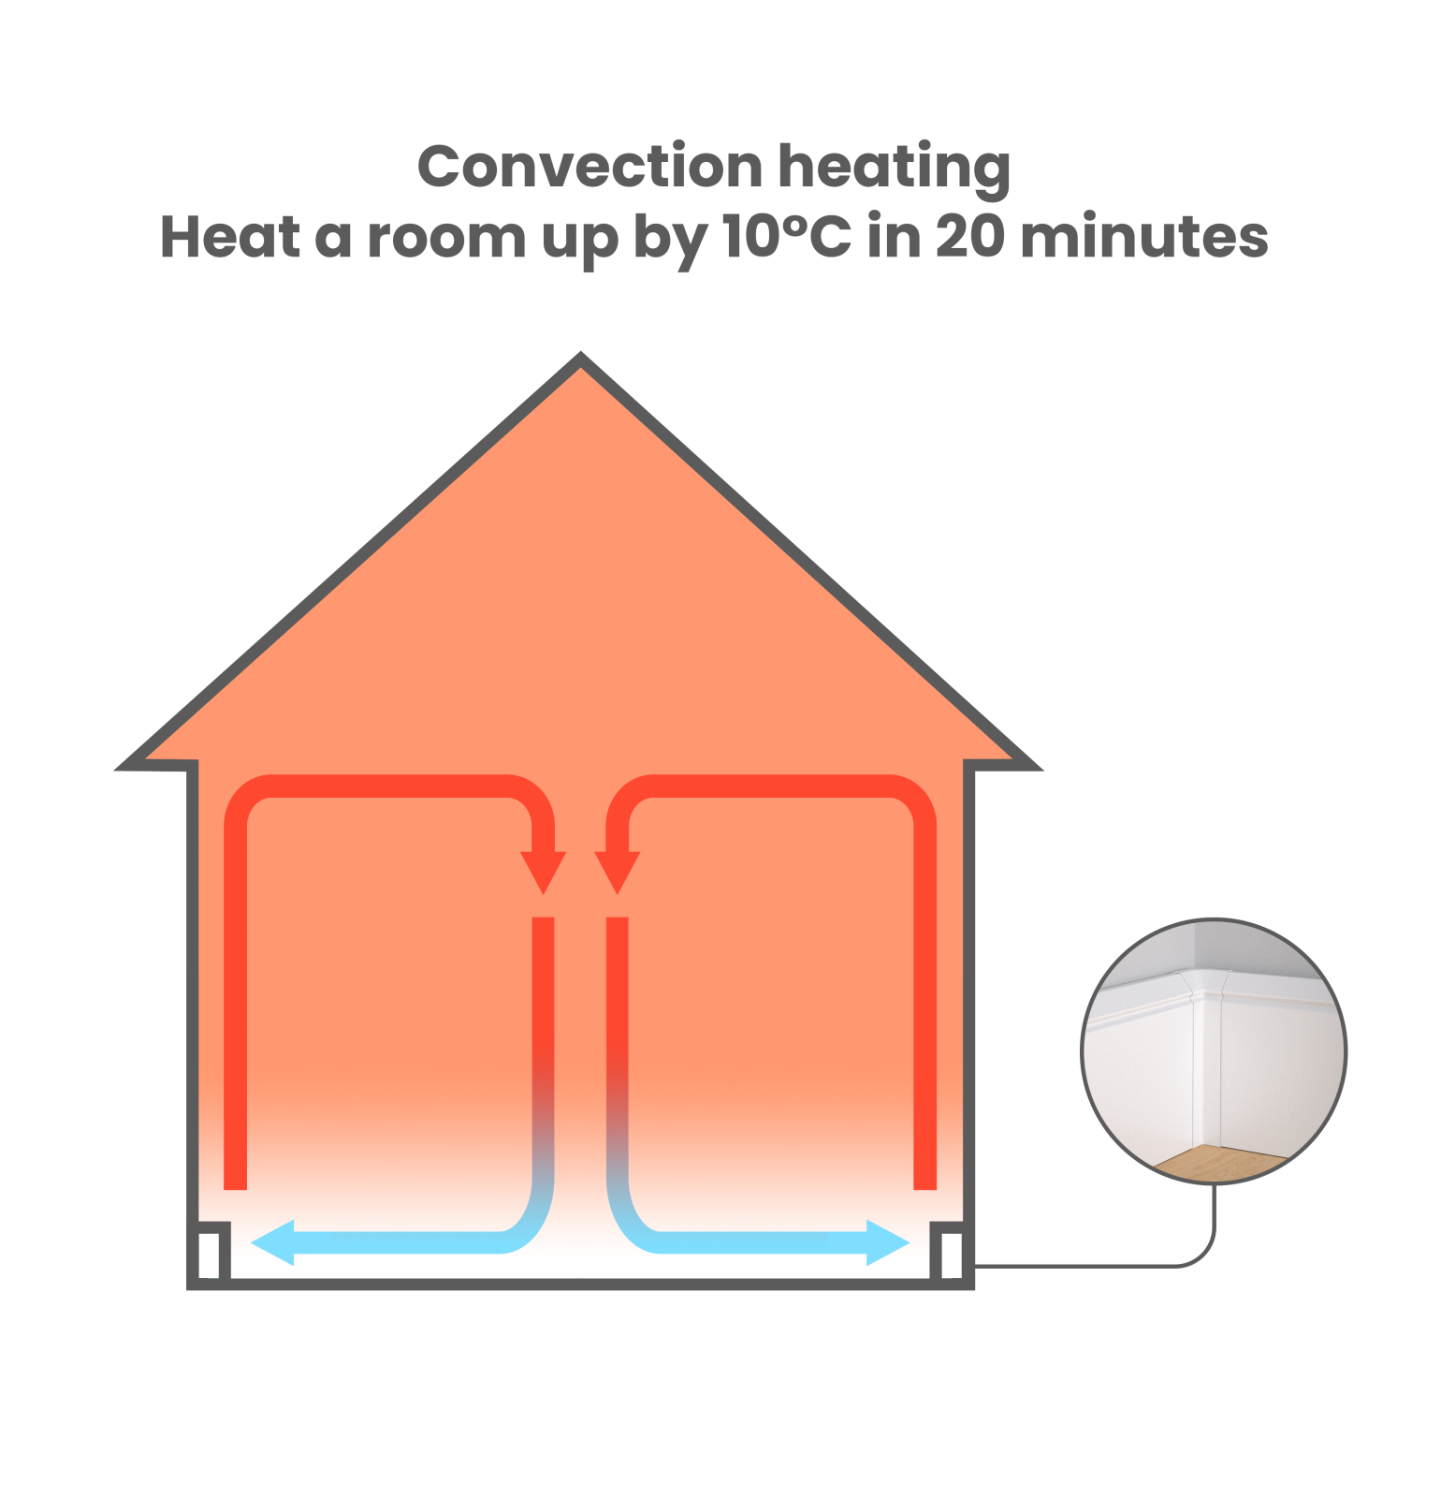

What is HeatENE?
Heat the home faster and more evenly than conventional systems using infrared & radiant heat emitting aluminium skirting boards.
HeatENE Graphene Technology
Fully electric system
Minimal Design – no more ugly radiators!
Heats with convection currents, no cold spots

Slide 3

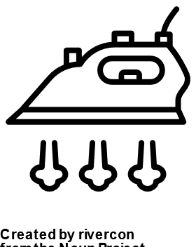
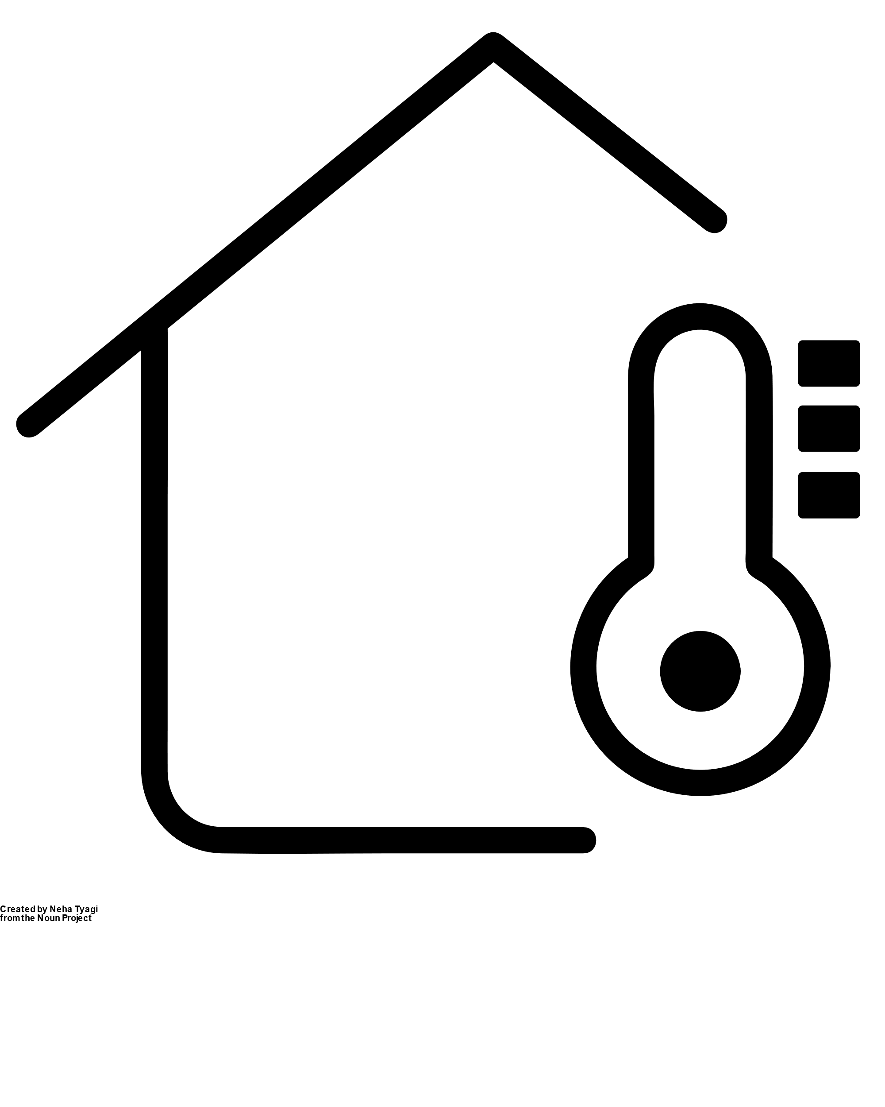
WHY HEATENE?
The low energy alternative
HeatENE requires only 70watt per metre to heat
1540w
2500w +
2400w
To heat the entire
1B-L1 unit (43m2)
To heat a kettle
To heat an iron

Slide 4
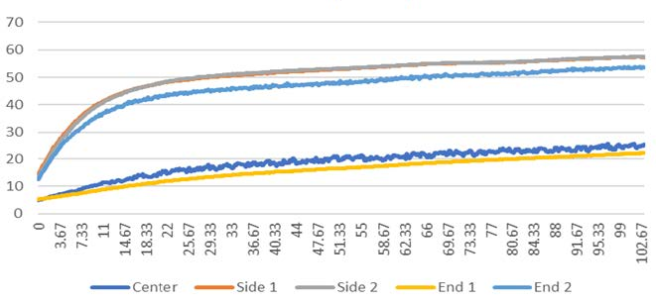

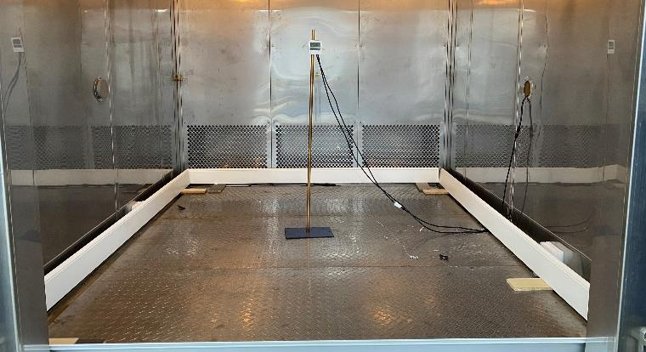


Heating performance graph
Temp ºC ->
WHY HEATENE?
High efficiency & performance
Time ->
Heat a room by 10 degrees in 20 minutes - tested
Surface temp maximum 55℃, child safe
No dusty radiator, less invasive than underfloor heating, easy to clean

Slide 5




WHY HEATENE?
Tested &
guaranteed
You can feel confident HeatENE will stay safe and work effectively for years to come.
IEC 60335-2-30: Household Safety
IPx5: Waterproof
10 years warranty

Slide 6
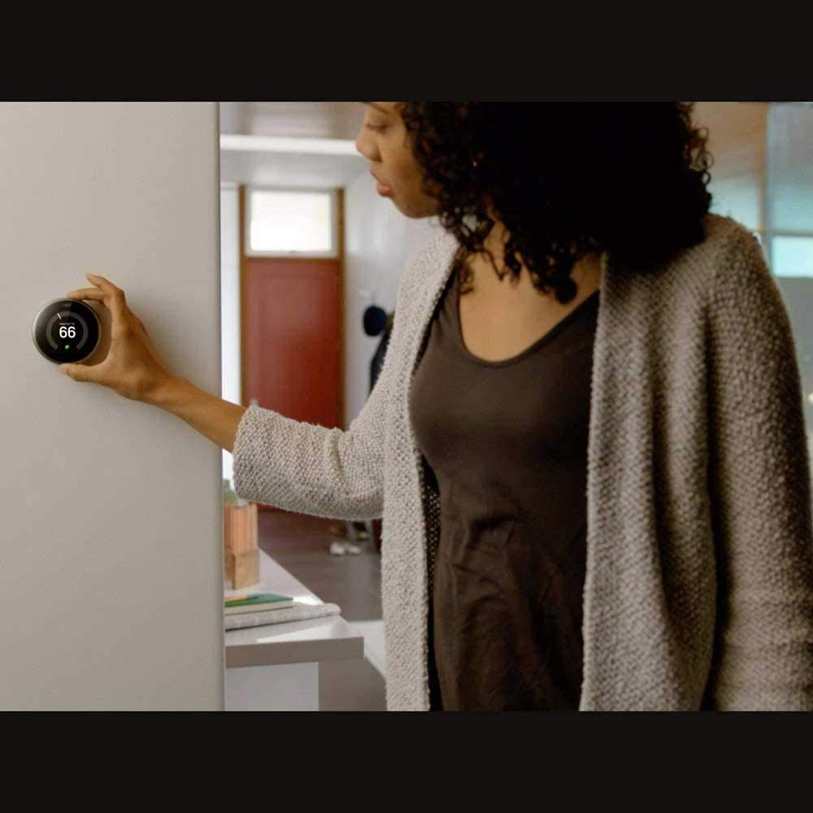





WHY HEATENE?
App control
integration
HeatENE while produced in Vietnam, is supplied ready to connect to any smart home system. or thermostat in the UK.

Slide 7
WHY HEATENE?
Smart system
integration
HeatENE while produced in Vietnam, is supplied ready to connect to any smart home system or thermostat in the UK.

Slide 8
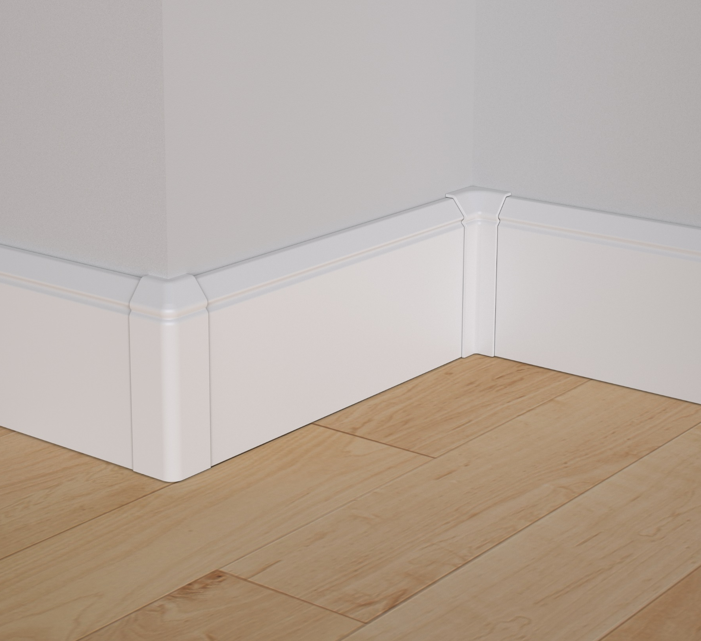
WHY HEATENE?
Simple
installation
Quick and easy snap fit installation
No difficult mitered corner joints required
No plumbing required for installation
Simple to cut to length (available in up to 6m lengths).

Slide 9
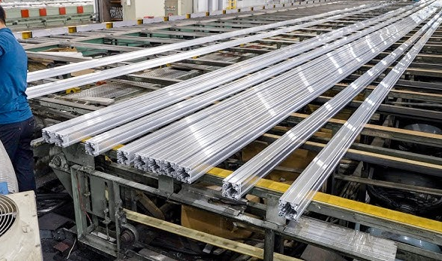
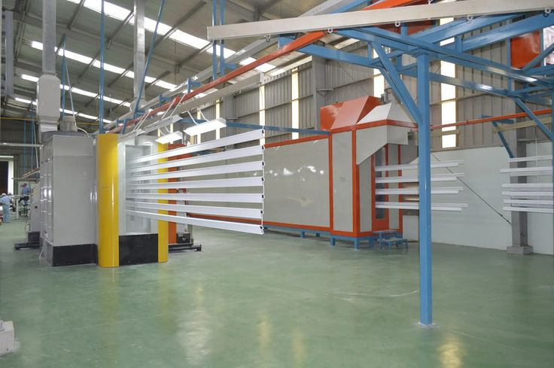
WHY HEATENE?
Production
We have working partnerships with experienced factories in Vietnam for both aluminium extrusions and powder coating.
25 years of experience
ISO 9001: 2015
Japanese extrusion technology
Automated production lines

Slide 10
Aluminium Extrusion
6063 grade aluminium
Akzonobel 10 years warranty powder coat
Custom colour options available
Custom skirting profiles available
Technical
Specifications
Graphene Film
Infrared wavelength | Main wavelength | Thermal conversion efficiency | Surface temperature degree celsius | Temperature limitation | W/M
8-14μm | 9.3μm | 99.69% | 55℃ | <80℃ | 70

Slide 11
Any Questions?
Thank you for listening

